Slide 1
AUDIO SPOTLIGHTING
GROUP 03
GUIDED BY: ABRAHAM JOSEPH(03)
Mr . JAYADAS.C.K. ATHUL UNNIKRISHNAN(22)
ASSOCIATE PROFESOR DIBIN.C.T.(66)
ECE DEPARTMENT NIKHIL.K.(68)

Slide 2
Contents
What is audio spotlight?
Li-Fi method
Ultrasonic frequency method.
Working
Block Diagram
Parametric array.
Features
Advantage
Application
2
Govt. Model Engineering College

Slide 3
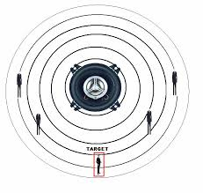
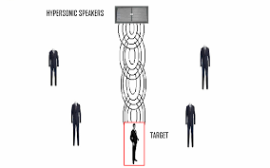
What is audio spotlight?
LOUD SPEAKER AUDIO SPOTLIGHT
3
Govt. Model Engineering College

Slide 4
Phases
Phase I : LIFI
Phase II : ULTRASONICS

Slide 5
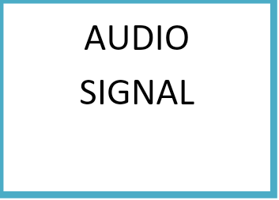
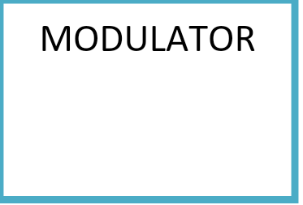
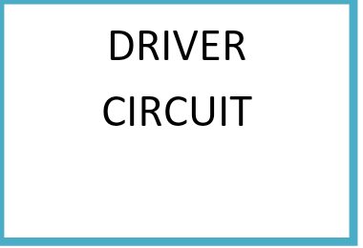
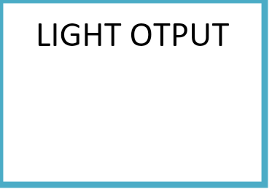

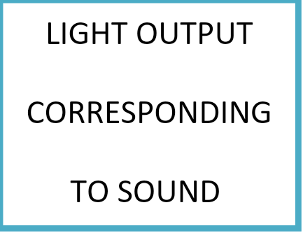
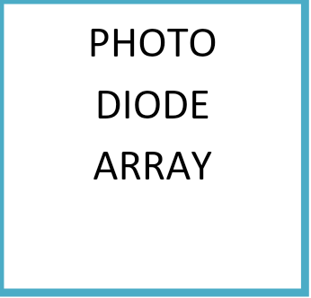
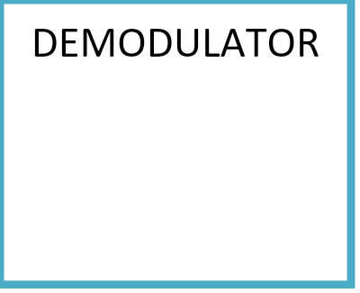
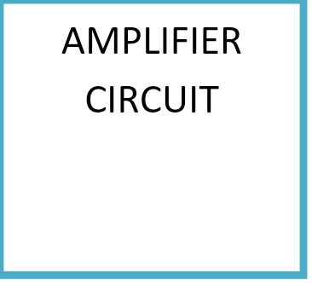
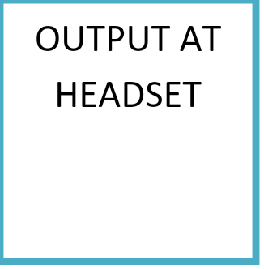
Method 1 Audio spotlight through Li-Fi
Transmitter section
Receiver section
5
Govt. Model Engineering College

Slide 6
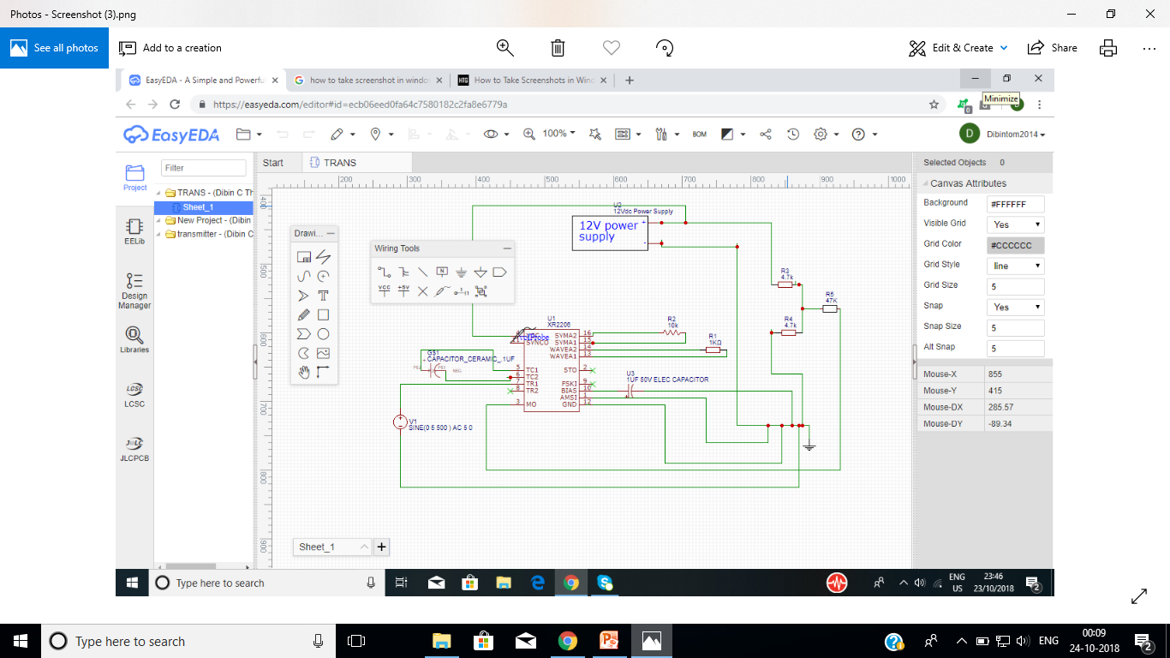
Circuit Diagram for Modulator

Slide 7
Disadvantages of Method 1
Size of headphone.
Difficult to wear.
Extra modulated and demodulated circuit is needed.
Less number of people.

Slide 8
Method 2 Ultrasonic Frequency
Increasing the frequency.
Narrowing the beam width.
Locating specific target.
8
Govt. Model Engineering College

Slide 9
Working of Method 2
Human voice is transferred to ultrasonic frequency.
Air as a demodulator.
Exploiting non linearity of air.

Slide 10
Block Diagram for Method 2
Power supply
Frequency oscillator
Modulator
Ultrasonic amplifier
Audio pre amplifier
Monolithic film transducer
Parametric array
MCU
Audio signal processor

Slide 11
Introduction to Parametric array
Standard approach
Example 500Hz
Array signal processing with multiple loud speakers.

Slide 12
Parametric array theory
Different frequencies
Inter-modulation products.
Demodulation by air.

Slide 13
Features
Can focus sound at specific place one’s want.
Shaper directivity than conventional loudspeaker.
Uses non linearity of air for demodulation.
No lag in reproducing the sound
13
Govt. Model Engineering College
Notes:
13
Department of Electronics and Communication Engineering
Govt. Model Engineering College, Thrikkakara

Slide 14
Advantages
Ultimate control in audio placement.
Minimizes noise pollution.
Ease of installation.
Lowest maintenance cost.
Single source.
14
Govt. Model Engineering College

Slide 15
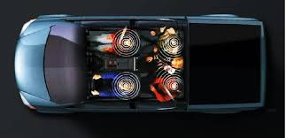


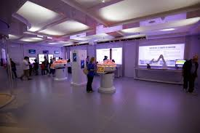
Applications

Slide 16
Current Status
Familiarised modulator IC
Working on simulation part of phase.

Slide 17
References
[1] Prof. Vasantkumar K Upadhye, Premkumar N Role, “Audio Spotlighting”, in
International Journal of New Innovations in Engineering and Technology,
Volume 4 Issue 3 – March 2016, pp. 24-29.
[2] D. Alon and B. Rafaely, “Spherical microphone array with optimal aliasing cancellation”, in Proc. 27th Conv. Electrical Electron. Eng. Israel (IEEEI), Nov. 2012, pp.1-5.
[3] Ayushi Kaushik, Jyoti Pandey, Neha Tomar, “AUDIO SPOTLIGHT”, International Journal Of Advance Research In Science And Engineering IJARSE, Vol. No.2, Issue No.10, October 2013, pp.115-122.

Slide 18
APPENDIX
xr2206.pdf

Slide 19

19

